Slide 1
Databases Security

Slide 2
Database security : refers to protection from malicious access.
Authentication: is a process of verifying who you are.
Authorization: is the process of verifying that you have access to something.

Slide 3
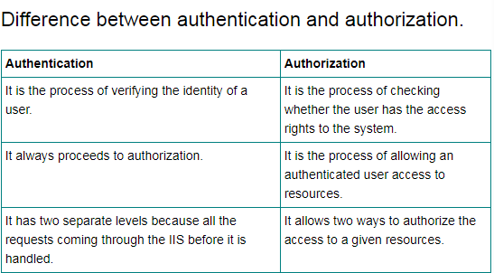

Slide 4
Authorization:
Authorization to access and modify data:
Read
Insert
Update
Delete
Authorization to modify database schema:
Index
Resource
Alter
Drop

Slide 5
Policy
Organizational policy
Information systems policy

Slide 6
Database Security Issues
Types of Security
Legal and ethical issues:
Right to access some certain information.
Some information may be deemed to be private and cannot be accessed legally by unauthorized person.
Policy issues
At the government level ,institution level or corporate level as to what kind of information will made publicly available eg. Credit rating, medical records etc.

Slide 7
System-related issues
At which system level security functions should be handeled.eg. Hardware level, operating system level , DBMS level.
The need to identify multiple security levels
Apply security on different categories of data and users.

Slide 8
Database Security
Protect Sensitive Data from
Unauthorized disclosure
Unauthorized modification
Denial of service attacks
Security Controls
Security Policy
Access control models
Integrity protection
Privacy problems
Fault tolerance and recovery
Auditing and intrusion detection

Slide 9
Security Objectives
Prevent/detect/deter improper
Disclosure of information
Secrecy
Prevent/detect/deter
Improper modification
of information
Integrity
Availability
Prevent/detect/deter improper
Denial of access to services

Slide 10
Database Security Issues
Threats to databases : Degradation some or all security goals.
Loss of integrity
Database integrity refers to the requirement that information be protected from improper modification.
Modification of data includes creation , insertion, modification etc.
Integrity is lost if unauthorized changes are made to the data by either intentional or accidental acts.
Loss of availability
Making object available to a human user or a program to which they have a legitimate right.
Loss of confidentiality
Refers to the protection of data from unauthorized disclosure.

Slide 11
Database Security Issues
A DBMS typically includes a database security and authorization subsystem that is responsible for ensuring the security portions of a database against unauthorized access.
Two types of database security mechanisms:
Discretionary security mechanisms
These are used to grant privileges to user including capability to access specific data files,records,or fields in a specific mode.(insert, update,delete etc)

Slide 12
Mandatory security mechanisms
These are used to enforce multilevel security by classifying the data and users into various security classes(or levels) and then implementing the appropriate security policies of the organization.
Security policy is to permit users at a certain classification level to see only the data items classified at the users own classification level.
E.g. Role based security.

Slide 13
Control measures:
To protect databases against these types of threats four kinds of countermeasures(an action taken against an unwanted action ) can be implemented:
Access control
is Mechanism which includes mechanism for restriction access to the database system as a whole
Inference control
to prevent process of inferring information from statistical data
Flow control
Which prevents information from flowing in such a way that it reaches unauthorized user.
Data Encryption
Is used to protect sensitive data(such as passward, credit card number etc) that is transmitted via some type of communication N/W.The data is encoded using certain coding algorithm.

Slide 14
Database Security and the DBA
The database administrator (DBA) is the central authority for managing a database system.
The DBA’s responsibilities include
granting privileges to users who need to use the system
classifying users and data in accordance with the policy of the organization
The DBA is responsible for the overall security of the database system.

Slide 15
Database Security and the DBA (2)
The DBA has a DBA account in the DBMS
Sometimes these are called a system or superuser account
These accounts provide powerful capabilities such as:
1. Account creation
2. Privilege granting
3. Privilege revocation
4. Security level assignment
Action 1 is access control, whereas 2 and 3 are discretionarym and 4 is used to control mandatory authorization

Slide 16
Access Protection, User Accounts, and Database Audits
Whenever a person or group of person s need to access a database system, the individual or group must first apply for a user account.
The DBA will then create a new account id and password for the user if he/she deems there is a legitimate need to access the database
The user must log in to the DBMS by entering account id and password whenever database access is needed.

Slide 17
Access Protection, User Accounts, and Database Audits(2)
The database system must also keep track of all operations on the database that are applied by a certain user throughout each login session.
To keep a record of all updates applied to the database and of the particular user who applied each update, we can modify system log, which includes an entry for each operation applied to the database that may be required for recovery from a transaction failure or system crash.

Slide 18
Access Protection, User Accounts, and Database Audits(3)
If any tampering with the database is suspected, a database audit is performed
A database audit consists of reviewing the log to examine all accesses and operations applied to the database during a certain time period.
A database log that is used mainly for security purposes is sometimes called an audit trail.

Slide 19
Access Control
Access control components:
- Access control policy: specifies the
authorized accesses of a system
- Access control mechanism: implements
and enforces the policy

Slide 20
Access Control (Protection of Data Confidentiality)
Access control is Mechanism which includes mechanism for restriction access to the database system as a whole.
Access Control is handled by creating user accounts and password to control access to the unauthorized data.
Access control – which data users can access

Slide 21
Access Control
Ensures that all direct accesses to object are authorized
Protects against accidental and malicious threats by regulating the read, write and execution of data and programs

Slide 22
Access Control
Requires:
- Proper user identification
- Information specifying the access rights is protected form modification

Slide 23
Access Control
Subject: active entity that requests access to an object
- e.g., user or program
Object: passive entity accessed by a subject
- e.g., record, relation, file
Access right (privileges): how a subject is allowed to access an object
- e.g., subject s can read object o

Slide 24
Access Control Policies
Discretionary Access Control (DAC)
Mandatory Access Control (MAC)
Role-Based Access Control (RBAC)

Slide 25
Discretionary Access Control Based on Granting and Revoking Privileges
The typical method of enforcing discretionary access control in a database system is based on the granting and revoking privileges.

Slide 26
2.1Types of Discretionary Privileges
The account level:
At this level, the DBA specifies the particular privileges that each account holds independently of the relations in the database.
The relation level (or table level):
At this level, the DBA can control the privilege to access each individual relation or view in the database.

Slide 27
2.1Types of Discretionary Privileges(2)
The privileges at the account level apply to the capabilities provided to the account itself and can include
the CREATE SCHEMA or CREATE TABLE privilege, to create a schema or base relation;
the CREATE VIEW privilege;
the ALTER privilege, to apply schema changes such adding or removing attributes from relations;
the DROP privilege, to delete relations or views;
the MODIFY privilege, to insert, delete, or update tuples;
and the SELECT privilege, to retrieve information from the database by using a SELECT query.

Slide 28
2.1Types of Discretionary Privileges(3)
The second level of privileges applies to the relation level
This includes base relations and virtual (view) relations.
The granting and revoking of privileges generally follow an authorization model for discretionary privileges known as the access matrix model where
The rows of a matrix M represents subjects (users, accounts, programs)
The columns represent objects (relations, records, columns, views, operations).
Each position M(i,j) in the matrix represents the types of privileges (read, write, update) that subject i holds on object j.

Slide 29
2.1Types of Discretionary Privileges(4)
To control the granting and revoking of relation privileges, each relation R in a database is assigned an owner account, which is typically the account that was used when the relation was created in the first place.
The owner of a relation is given all privileges on that relation.
In SQL2, the DBA can assign and owner to a whole schema by creating the schema and associating the appropriate authorization identifier with that schema, using the CREATE SCHEMA command.
The owner account holder can pass privileges on any of the owned relation to other users by granting privileges to their accounts.

Slide 30
2.1Types of Discretionary Privileges(5)
In SQL the following types of privileges can be granted on each individual relation R:
SELECT (retrieval or read) privilege on R:
Gives the account retrieval privilege.
In SQL this gives the account the privilege to use the SELECT statement to retrieve tuples from R.
MODIFY privileges on R:
This gives the account the capability to modify tuples of R.
In SQL this privilege is further divided into UPDATE, DELETE, and INSERT privileges to apply the corresponding SQL command to R.
In addition, both the INSERT and UPDATE privileges can specify that only certain attributes can be updated by the account.

Slide 31
2.1Types of Discretionary Privileges(6)
In SQL the following types of privileges can be granted on each individual relation R (contd.):
REFERENCES privilege on R:
This gives the account the capability to reference relation R when specifying integrity constraints.
The privilege can also be restricted to specific attributes of R.
Notice that to create a view, the account must have SELECT privilege on all relations involved in the view definition.

Slide 32
Authorization:
Authorization to access and modify data:
Read
Insert
Update
Delete
Authorization to modify database schema:
Index
Resource
Alter
Drop

Slide 33
Authorization Specification
The grant statement is used to confer authorization
grant <privilege list> on <relation/view name> to <user list>
<user list> is:
user id
public, which allows all valid users the privilege granted a role
Granting a privilege on a view does not imply granting any privileges on the underlying relations.
The grant or of the privilege must already hold the privilege
on the specified item (or be the database administrator)

Slide 34
Privileges in SQL
select: allows read access to relation,or the ability to query
using the view
Example: grant users U1, U2, and U3 select authorization
on the branch relation:
grant select on branch to U1,U2,U3 with grant option
insert: the ability to insert tuples
update: the ability to update using the SQL update statement
delete: the ability to delete tuples.
references: ability to declare foreign keys when creating relations
usage: authorizes a user to use a specified domain
all privileges: used as a short form for all the allowable privileges

Slide 35
with grant option: allows a user who is granted a privilege
to pass the privilege on to other users
Example:
grant select on branch to U1 with grant option
gives U1 the select privileges on branch and allows U1 to grant this privilege to others.

Slide 36
Revoking privilege:
The revoke statement is used to revoke authorization
revoke <privilege list> on <relation/view name> from <user list> [restrict|cascade]
Example:
revoke select on branch from U1,U2,U3 cascade
<privilege-list> may be all to revoke all privileges
If <user-list> includes public, all users lose the privilege except those granted it explicitly
Revocation of a privilege from a user may cause other users also to lose that privilege (cascading)
With restrict, the revoke command fails if cascading revokes are required
All privileges that depend on the privilege being revoked are also revoked

Slide 37
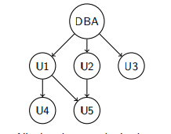
Granting of Privileges:
The passage of authorization from one user to another may be represented by an authorization graph.
Requirement: All edges in an authorization graph must be
part of some path originating with the database administrator
Must prevent cycles of grants with no path from the root

Slide 38
2.2 Specifying Privileges Using Views
The mechanism of views is an important discretionary authorization mechanism in its own right. For example,
If the owner A of a relation R wants another account B to be able to retrieve only some fields of R, then A can create a view V of R that includes only those attributes and then grant SELECT on V to B.
The same applies to limiting B to retrieving only certain tuples of R; a view V’ can be created by defining the view by means of a query that selects only those tuples from R that A wants to allow B to access.

Slide 39
2.3 Revoking Privileges
In some cases it is desirable to grant a privilege to a user temporarily. For example,
The owner of a relation may want to grant the SELECT privilege to a user for a specific task and then revoke that privilege once the task is completed.
Hence, a mechanism for revoking privileges is needed. In SQL, a REVOKE command is included for the purpose of canceling privileges.

Slide 40
2.4 Propagation of Privileges using the GRANT OPTION
Whenever the owner A of a relation R grants a privilege on R to another account B, privilege can be given to B with or without the GRANT OPTION.
If the GRANT OPTION is given, this means that B can also grant that privilege on R to other accounts.
Suppose that B is given the GRANT OPTION by A and that B then grants the privilege on R to a third account C, also with GRANT OPTION. In this way, privileges on R can propagate to other accounts without the knowledge of the owner of R.
If the owner account A now revokes the privilege granted to B, all the privileges that B propagated based on that privilege should automatically be revoked by the system.

Slide 41
2.5 An Example
Suppose that the DBA creates four accounts
A1, A2, A3, A4
and wants only A1 to be able to create base relations. Then the DBA must issue the following GRANT command in SQL
GRANT CREATETAB TO A1;
In SQL2 the same effect can be accomplished by having the DBA issue a CREATE SCHEMA command as follows:
CREATE SCHAMA EXAMPLE AUTHORIZATION A1;

Slide 42
2.5 An Example(2)
User account A1 can create tables under the schema called EXAMPLE.
Suppose that A1 creates the two base relations EMPLOYEE and DEPARTMENT
A1 is then owner of these two relations and hence all the relation privileges on each of them.
Suppose that A1 wants to grant A2 the privilege to insert and delete tuples in both of these relations, but A1 does not want A2 to be able to propagate these privileges to additional accounts:
GRANT INSERT, DELETE ON
EMPLOYEE, DEPARTMENT TO A2;

Slide 43
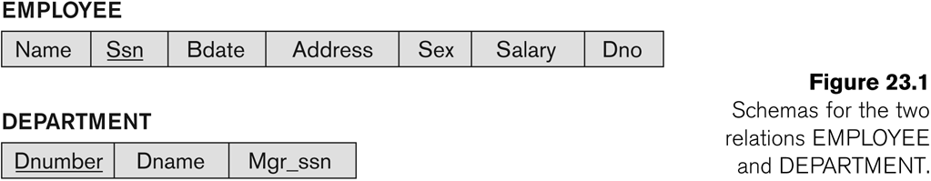
2.5 An Example(3)

Slide 44
2.5 An Example(4)
Suppose that A1 wants to allow A3 to retrieve information from either of the two tables and also to be able to propagate the SELECT privilege to other accounts.
A1 can issue the command:
GRANT SELECT ON EMPLOYEE, DEPARTMENT
TO A3 WITH GRANT OPTION;
A3 can grant the SELECT privilege on the EMPLOYEE relation to A4 by issuing:
GRANT SELECT ON EMPLOYEE TO A4;
Notice that A4 can’t propagate the SELECT privilege because GRANT OPTION was not given to A4

Slide 45
2.5 An Example(5)
Suppose that A1 decides to revoke the SELECT privilege on the EMPLOYEE relation from A3; A1 can issue:
REVOKE SELECT ON EMPLOYEE FROM A3;
The DBMS must now automatically revoke the SELECT privilege on EMPLOYEE from A4, too, because A3 granted that privilege to A4 and A3 does not have the privilege any more.

Slide 46
2.5 An Example(6)
Suppose that A1 wants to give back to A3 a limited capability to SELECT from the EMPLOYEE relation and wants to allow A3 to be able to propagate the privilege.
The limitation is to retrieve only the NAME, BDATE, and ADDRESS attributes and only for the tuples with DNO=5.
A1 then create the view:
CREATE VIEW A3EMPLOYEE AS
SELECT NAME, BDATE, ADDRESS
FROM EMPLOYEE
WHERE DNO = 5;
After the view is created, A1 can grant SELECT on the view A3EMPLOYEE to A3 as follows:
GRANT SELECT ON A3EMPLOYEE TO A3
WITH GRANT OPTION;

Slide 47
2.5 An Example(7)
Finally, suppose that A1 wants to allow A4 to update only the SALARY attribute of EMPLOYEE;
A1 can issue:
GRANT UPDATE ON EMPLOYEE (SALARY) TO A4;
The UPDATE or INSERT privilege can specify particular attributes that may be updated or inserted in a relation.
Other privileges (SELECT, DELETE) are not attribute specific.

Slide 48
Discretionary Access Control:
Owner decides the access policy for the object.
In DAC user has different access rights or privileges on different objects.
Grant and Revoke commands are used.

Slide 49
Mandatory Access control:
Typical security classes are top secret (TS),secret (S),confidential (C),and unclassified (U),where TS is the highest level and U the lowest.
Other more complex security classification schemes exist, in which the security classes are organized in a lattice.
For simplicity, we will use the system with four security classification levels, where TS ≥ S ≥ C ≥ U, to illustrate our discussion.
The commonly used model for multilevel security, known as the Bell-LaPadula model, classifies each subject (user,account,program) and object (relation,tuple,column,view,operation) into one of the security classifications TS, S, C, or U.
We will refer to the clearance (classification) of a subject S as class(S) and to the classification of an object O as class(O).

Slide 50
Two restrictions are enforced on data access based on the subject/object classifications:
1. A subject S is not allowed read access to an object O unless class(S) ≥ class(O).This is known as the simple security property.
2. A subject S is not allowed to write an object O unless class(S)≤class(O).This is known as the star property (or *-property).

Slide 51
The first restriction is intuitive and enforces the obvious rule that no subject can read an object whose security classification is higher than the subject’s security clearance.
The second restriction is less intuitive. It prohibits a subject from writing an object at a lower security classification than the subject’s security clearance.

Slide 52
To incorporate multilevel security notions into the relational database model, it is common to consider attribute values and tuples as data objects.
Hence, each attribute A is associated with a classification attribute C in the schema, and each attribute value in a tuple is associated with a corresponding security classification.
In addition, in some models, a tuple classification attribute TC is added to the relation attributes to provide a classification for each tuple as a whole.
The model we describe here is known as the multilevel model, because it allows classifications at multiple security levels.
A multilevel relation schema R with n attributes would be represented as: R(A1, C1, A2, C2, ..., An, Cn,TC)

Slide 53
Comparing Discretionary Access Control and Mandatory Access Control
Discretionary access control (DAC) policies are characterized by a high degree of flexibility, which makes them suitable for a large variety of application domains.
The main drawback of DAC models is their vulnerability to malicious attacks, such as Trojan horses embedded in application programs.
The reason is that discretionary authorization models do not impose any control on how information is propagated and used once it has been accessed by users authorized to do so. By contrast, mandatory policies ensure a high degree of protection—in a way, they prevent

Slide 54
any illegal flow of information.
Therefore, they are suitable for military and high security types of applications, which require a higher degree of protection.
However, mandatory policies have the drawback of being too rigid in that they require a strict classification of subjects and objects into security levels, and therefore they are applicable to few environments. I
n many practical situations, discretionary policies are preferred because they offer a better tradeoff between security and applicability.

Slide 55
3 Mandatory Access Control and Role-Based Access Control for Multilevel Security
The discretionary access control techniques of granting and revoking privileges on relations has traditionally been the main security mechanism for relational database systems.
This is an all-or-nothing method:
A user either has or does not have a certain privilege.
In many applications, and additional security policy is needed that classifies data and users based on security classes.
This approach as mandatory access control, would typically be combined with the discretionary access control mechanisms.

Slide 56
3 Mandatory Access Control and Role-Based Access Control for Multilevel Security(2)
Typical security classes are top secret (TS), secret (S), confidential (C), and unclassified (U), where TS is the highest level and U the lowest: TS ≥ S ≥ C ≥ U
The commonly used model for multilevel security, known as the Bell-LaPadula model, classifies each subject (user, account, program) and object (relation, tuple, column, view, operation) into one of the security classifications, T, S, C, or U:
Clearance (classification) of a subject S as class(S) and to the classification of an object O as class(O).

Slide 57
3 Mandatory Access Control and Role-Based Access Control for Multilevel Security(3)
Two restrictions are enforced on data access based on the subject/object classifications:
Simple security property: A subject S is not allowed read access to an object O unless class(S) ≥ class(O).
A subject S is not allowed to write an object O unless class(S) ≤ class(O). This known as the star property (or * property).

Slide 58
3 Mandatory Access Control and Role-Based Access Control for Multilevel Security(4)
To incorporate multilevel security notions into the relational database model, it is common to consider attribute values and tuples as data objects.
Hence, each attribute A is associated with a classification attribute C in the schema, and each attribute value in a tuple is associated with a corresponding security classification.
In addition, in some models, a tuple classification attribute TC is added to the relation attributes to provide a classification for each tuple as a whole.
Hence, a multilevel relation schema R with n attributes would be represented as
R(A₁,C₁,A₂,C₂, …, A_{n},C_{n},TC)
where each Ci represents the classification attribute associated with attribute A_{i}.

Slide 59
3 Mandatory Access Control and Role-Based Access Control for Multilevel Security(5)
The value of the TC attribute in each tuple t – which is the highest of all attribute classification values within t – provides a general classification for the tuple itself, whereas each C_{i} provides a finer security classification for each attribute value within the tuple.
The apparent key of a multilevel relation is the set of attributes that would have formed the primary key in a regular(single-level) relation.

Slide 60
3 Mandatory Access Control and Role-Based Access Control for Multilevel Security(6)
A multilevel relation will appear to contain different data to subjects (users) with different clearance levels.
In some cases, it is possible to store a single tuple in the relation at a higher classification level and produce the corresponding tuples at a lower-level classification through a process known as filtering.
In other cases, it is necessary to store two or more tuples at different classification levels with the same value for the apparent key.
This leads to the concept of polyinstantiation where several tuples can have the same apparent key value but have different attribute values for users at different classification levels.

Slide 61
3 Mandatory Access Control and Role-Based Access Control for Multilevel Security(7)
In general, the entity integrity rule for multilevel relations states that all attributes that are members of the apparent key must not be null and must have the same security classification within each individual tuple.
In addition, all other attribute values in the tuple must have a security classification greater than or equal to that of the apparent key.
This constraint ensures that a user can see the key if the user is permitted to see any part of the tuple at all.

Slide 62
3 Mandatory Access Control and Role-Based Access Control for Multilevel Security(8)
Other integrity rules, called null integrity and interinstance integrity, informally ensure that if a tuple value at some security level can be filtered (derived) from a higher-classified tuple, then it is sufficient to store the higher-classified tuple in the multilevel relation.

Slide 63
3.1 Comparing Discretionary Access Control and Mandatory Access Control
Discretionary Access Control (DAC) policies are characterized by a high degree of flexibility, which makes them suitable for a large variety of application domains.
The main drawback of DAC models is their vulnerability to malicious attacks, such as Trojan horses embedded in application programs.

Slide 64
3.1 Comparing Discretionary Access Control and Mandatory Access Control(2)
By contrast, mandatory policies ensure a high degree of protection in a way, they prevent any illegal flow of information.
Mandatory policies have the drawback of being too rigid and they are only applicable in limited environments.
In many practical situations, discretionary policies are preferred because they offer a better trade-off between security and applicability.

Slide 65
3.2 Role-Based Access Control
Role-based access control (RBAC) emerged rapidly in the 1990s as a proven technology for managing and enforcing security in large-scale enterprisewide systems.
Its basic notion is that permissions are associated with roles, and users are assigned to appropriate roles.
Roles can be created using the CREATE ROLE and DESTROY ROLE commands.
The GRANT and REVOKE commands discussed under DAC can then be used to assign and revoke privileges from roles.

Slide 66
SQL GRANT REVOKE Commands
DCL commands are used to enforce database security in a multiple user database environment. Two types of DCL commands are GRANT and REVOKE. Only Database Administrator's or owner's of the database object can provide/remove privileges on a database object.
SQL GRANT Command
SQL GRANT is a command used to provide access or privileges on the database objects to the users.
The Syntax for the GRANT command is:
GRANT privilege_name ON object_name TO {user_name |PUBLIC |role_name} [WITH GRANT OPTION];

Slide 67
privilege_name is the access right or privilege granted to the user. Some of the access rights are ALL, EXECUTE, and SELECT.
object_name is the name of an database object like TABLE, VIEW, STORED PROC and SEQUENCE.
user_name is the name of the user to whom an access right is being granted.
user_name is the name of the user to whom an access right is being granted.
PUBLIC is used to grant access rights to all users.
ROLES are a set of privileges grouped together.
WITH GRANT OPTION - allows a user to grant access rights to other users.

Slide 68
SQL REVOKE Command:
The REVOKE command removes user access rights or privileges to the database objects.
The Syntax for the REVOKE command is:
REVOKE privilege_name ON object_name FROM {user_name |PUBLIC |role_name}
For Example:
REVOKE SELECT ON employee FROM user1.
This command will REVOKE a SELECT privilege on employee table from user1.
When you REVOKE SELECT privilege on a table from a user, the user will not be able to SELECT data from that table anymore.

Slide 69
Privileges and Roles:
Privileges: Privileges defines the access rights provided to a user on a database object. There are two types of privileges.
1) System privileges - This allows the user to CREATE, ALTER, or DROP database objects. 2) Object privileges - This allows the user to EXECUTE, SELECT, INSERT, UPDATE, or DELETE data from database objects to which the privileges apply.

Slide 70
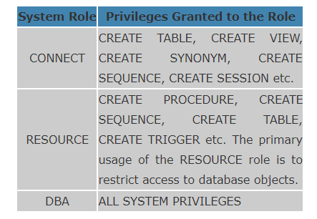
Roles: Roles are a collection of privileges or access rights.
When there are many users in a database it becomes difficult to grant or revoke privileges to users. Therefore, if you define roles, you can grant or revoke privileges to users, thereby automatically granting or revoking privileges. You can either create Roles or use the system roles pre-defined by oracle.
Some of the privileges granted to the system roles are as given below:

Slide 71
Creating Roles:
The Syntax to create a role is:
CREATE ROLE role_name [IDENTIFIED BY password];
For Example: To create a role called "developer" with password as "pwd",the code will be as follows
CREATE ROLE testing [IDENTIFIED BY pwd];

Slide 72
For example: To grant CREATE TABLE privilege to a user by creating a testing role:
First, create a testing Role
CREATE ROLE testing
Second, grant a CREATE TABLE privilege to the ROLE testing. You can add more privileges to the ROLE.
GRANT CREATE TABLE TO testing;
Third, grant the role to a user.
GRANT testing TO user1;
To revoke a CREATE TABLE privilege from testing ROLE, you can write:
REVOKE CREATE TABLE FROM testing;
The Syntax to drop a role from the database is as below:
DROP ROLE role_name;

Slide 73
3.2 Role-Based Access Control(2)
RBAC appears to be a viable alternative to traditional discretionary and mandatory access controls; it ensures that only authorized users are given access to certain data or resources.
Many DBMSs have allowed the concept of roles, where privileges can be assigned to roles.
Role hierarchy in RBAC is a natural way of organizing roles to reflect the organization’s lines of authority and responsibility.

Slide 74
3.2 Role-Based Access Control(3)
Another important consideration in RBAC systems is the possible temporal constraints that may exist on roles, such as time and duration of role activations, and timed triggering of a role by an activation of another role.
Using an RBAC model is highly desirable goal for addressing the key security requirements of Web-based applications.
In contrast, discretionary access control (DAC) and mandatory access control (MAC) models lack capabilities needed to support the security requirements emerging enterprises and Web-based applications.

Slide 75
GRANT ROLE full_time TO employee_type1
GRANT ROLE intern TO employee_type2 The above are examples of granting the roles

Slide 76
Advanced Data Models

Slide 77
Temporal Databases

Slide 78
Introduction
2
Typically, databases model only one state - the current state- of the real world, and do not store information about past states, except perhaps as audit trails.
When the state of the real world changes, the database gets updated, and information about the old state gets lost.
Applications usually require the knowledge of the information’s evolution, implying the storage of different states of information, including past values and future previews.
For example, a patient database must store information about the medical history of a patient.

Slide 79
Introduction
3
A factory monitoring system may store information about current and past readings of sensors in the factory, for analysis.
This led to the development of researches concerning temporal aspects in information systems.
Databases that store information about states of the real world across
time are called temporal databases.
Temporal databases, in the broadest sense, encompass all database applications that require some aspect of time when organizing their information.

Slide 80
Introduction
4
There are many other examples of applications (reservation systems, scientific databases, company database, university database etc.) where some aspect of time is needed to maintain the information in a database.
Insurance, where claims and accident histories are required as well as
information about the times when insurance policies are in effect;
Reservation systems in general (hotel, airline, car rental, train, and so on), where information on the dates and times when reservations are in effect are required;
Scientific databases, where data collected from experiments includes the time when each data is measured; and so on.

Slide 81
Introduction
5
In the COMPANY database, we may wish to keep SALARY, JOB, and PROJECT histories on each employee.
In the UNIVERSITY database, time is already included in the SEMESTER and YEAR of each SECTION of a COURSE, the grade history of a STUDENT, and the information on research grants.
In fact, it is realistic to conclude that the majority of database
applications have some temporal information.
However, users often attempt to simplify or ignore temporal aspects
because of the complexity that they add to their applications.

Slide 82
Introduction
6
Temporal databases allow the storage and the recovery of all the states assumed by an object during its lifetime, thus recording its evolution with time.
When considering the issue of time in database systems, we must distinguish between time as measured by the system and time as observed in the real world.
The valid time for a fact is the set of time intervals during which the fact is true in the real world.
The transaction time for a fact is the time interval during which the fact is current within the database system.

Slide 83
Introduction
7
This latter time is based on the transaction serialization order and is generated automatically by the system.
Note that valid-time intervals, being a real-world concept, cannot be generated automatically and must be provided to the system.
A temporal relation is one where each tuple has an associated time when it is true; the time may be either valid time or transaction time.
When both timestamps are used the result is a bitemporal relation.

Slide 84
Time Representation
8
For temporal databases, time is considered to be an ordered sequence
of points in some granularity that is determined by the application.
Temporal database researchers have used the term chronon instead of point to describe the minimal granularity for a particular application.
A calendar organizes time into different time units for convenience.
Various calendars are used by various cultures (such as Gregorian (western), Chinese, Islamic, Hindu, Jewish, Coptic etc.).

Slide 85
Time Representation in SQL
9
In SQL2, temporal data types include DATE, TIME, TIMESTAMP,
INTERVAL, and PERIOD.
DATE: The type date contains four digits for the year (1–9999), two digits for the month (1–12), and two digits for the date (1–31) and provided specifying Year, Month, and Day as YYYY-MM-DD),
TIME: The type time contains two digits for the hour, two digits for the minute, and two digits for the second, plus optional fractional digits and provided specifying Hour, Minute, and Second as HH:MM:SS,
TIMESTAMP: The type timestamp contains the fields of date and time, with six fractional digits for the seconds field. (specifying a Date/Time combination, with options for including sub second divisions if they are needed),

Slide 86
Time Representation in SQL
10
Since different places in the world have different local times, there is often a need for specifying the time zone along with the time.
The Universal Coordinated Time (UTC) is a standard reference point for specifying time, with local times defined as offsets from UTC. (The standard abbreviation is UTC, rather than UCT, since it is an abbreviation of “Universal Coordinated Time” written in French as universel temps coordonne ´.)
INTERVAL (a relative time duration, such as 10 days or 250 minutes),
PERIOD (an anchored time duration with a fixed starting point, such as the 10-day period from January 1, 2009, to January 10, 2009, inclusive).

Slide 87
Event Information Versus Duration (or State) Information
11
A temporal database will store information concerning when certain events occur, or when certain facts are considered to be true.
There are several different types of temporal information.
Point events or facts are typically associated in the database with a single time point in some granularity;
For example, bank deposit, total monthly sales associated with particular month (say, February 2010).
This type of information is often represented as time series data

Slide 88
Event Information Versus Duration (or State) Information
12
Duration events or facts are associated with a specific time period in the database;
A time period is represented by its start time and end time points;
Time period is often interpreted as the set of all time points from start-time to end-time inclusive in the specified granularity;
For example, employee worked in a company in a company from August 15, 2003 until November 20, 2008.
The above period is represented as [2003-08-15, 2008-11-20].

Slide 89
Valid Time and Transaction Time Dimensions
13
Given a particular event or fact that is associated with a particular time point or time period in the database, the association may be interpreted to mean different things.
The most natural interpretation is that the associated time is the time that the event occurred, or the period during which the fact was considered to be true in the real world.
The associated time that the event occurred, or the period during which the fact was considered to be true is called valid time;
The database using this interpretation is called valid time database

Slide 90
Valid Time and Transaction Time Dimensions
14
In transaction time, the associated time refers to the time when the information was actually stored in the database, that is, it is the value of the system time clock when the information is valid in the system; The database using this interpretation is called transaction time database
The above two are referred to as time dimensions;
In some applications only one of the dimensions is needed and in other cases both time dimensions are required, in which case the temporal database is called bitemporal database
If the user defines the semantics and program the applications appropriately, it is called user-defined time

Slide 91
Incorporating Time in Relational Databases Using Tuple Versioning
15
Let us now see how the different types of temporal databases may be represented in the relational model.
Valid Time Relations – We convert the relations into valid time relations by adding the attributes valid start time and valid end time
Transaction Time Relations – We convert the relations into transaction time relations by adding the attributes transaction start time and transaction end time
Bitemporal Relations – We convert the relations into bitemporal relations by adding the attributes valid start time, valid end time, transaction start time, and transaction end time

Slide 92
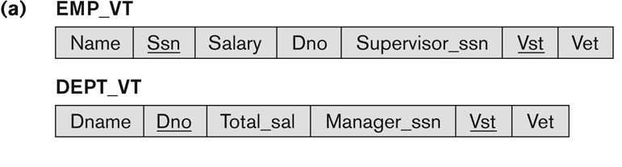
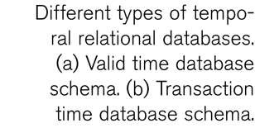
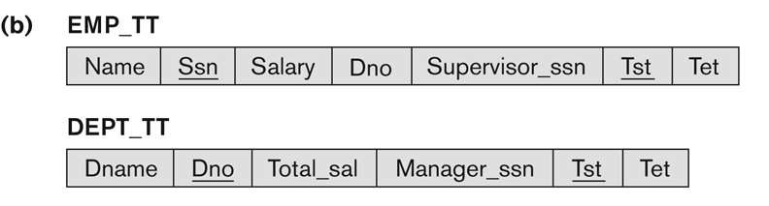
Incorporating Time in Relational Databases Using Tuple Versioning
16
Figure

Slide 93
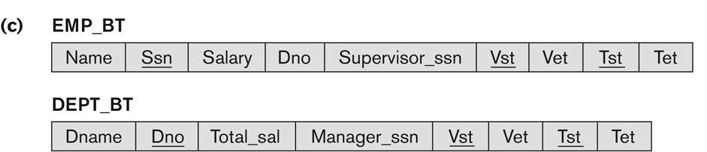
Incorporating Time in Relational Databases Using Tuple Versioning
17
Figure c : Bitemporal Database Schema

Slide 94
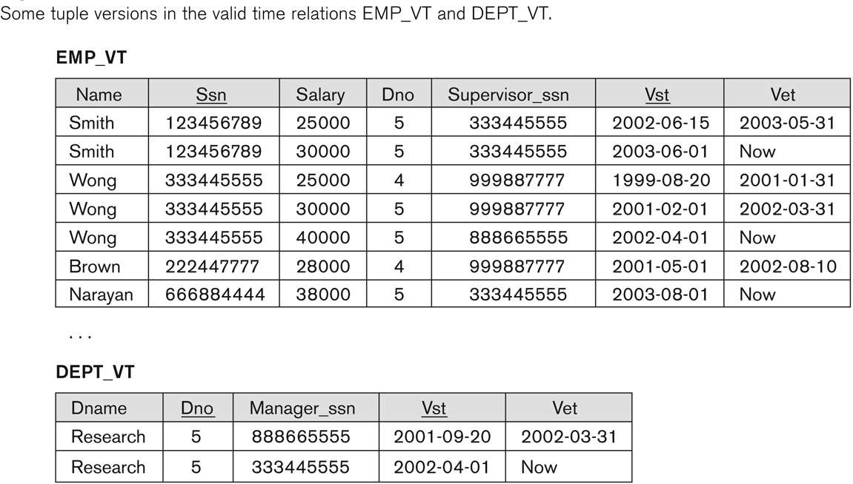
Incorporating Time in Relational Databases Using Tuple Versioning
18

Slide 95
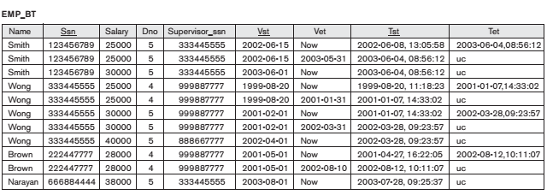
Incorporating Time in Relational Databases Using Tuple Versioning
19

Slide 96

Incorporating Time in Relational Databases Using Tuple Versioning
20
DEPT_BT

Slide 97
Incorporating Time in Relational Databases Using Tuple Versioning
21
Implementation Considerations
– There are various options for
storing the tuples in a temporal relation
Store all tuples in the same table
Create two table – one for the currently valid information and other for the rest of the tuples
Vertical partition the attributes of the temporal relation into separate relations – separate relation is created to contain only the attributes that always change synchronously

Slide 98
Incorporating Time in Object Databases Using Attribute Versioning
22
A single complex object is used to store all the temporal changes of object
Each attribute that changes over time is called a time-varying attribute (e.g., age), and it has its values versioned over time by adding temporal periods to the attribute
The temporal periods may represent valid time, transaction time, or bitemporal, depending on the application requirement
Attributes that do not change are called non-time-varying (e.g., date of birth)and are not associated with the temporal periods
Time varying attribute is represented as a collection type

Slide 99
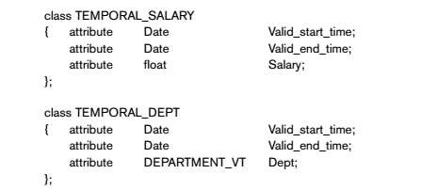
Incorporating Time in Object Databases Using Attribute Versioning
23

Slide 100
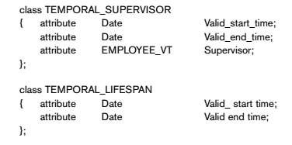
Incorporating Time in Object Databases Using Attribute Versioning
24

Slide 101
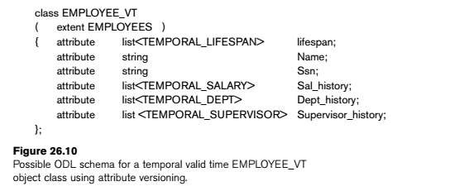
Incorporating Time in Object Databases Using Attribute Versioning
25

Slide 102
Time Series Data
26
Time series data are the data values that are recorded according to a specific predefined sequence of time periods.
They are special type of valid event data, where the event time points are predetermined according to a fixed calendar.
Example: closing daily stock prices of a particular Stock Exchange
Company. The granularity here is day.
Typical queries on time series involve temporal aggregation over higher granularity levels.
For example, finding the average or maximum weekly closing stock price or the maximum and minimum monthly closing stock price from the daily information.

Slide 103
Time Series Data
27
As another example, consider the daily sales dollar amount at each
store of a chain of stores owned by a particular company.
Again, typical temporal aggregates would be retrieving the weekly, monthly, or yearly sales from the daily sales information (using the sum aggregate function), or comparing same store monthly sales with previous monthly sales, and so on.
Because of the specialized nature of time series data and the lack of support for it in older DBMSs, it has been common to use specialized time series management systems rather than general- purpose DBMSs for managing such information.

Slide 104
Mobile Database
A Mobile database is a database that can be connected to a mobile computing device over a mobile network (or wireless network).
Here the client and the server have wireless connections.
Mobile computing is growing very rapidly, and it is huge potential in the field of the database.
It will be applicable on different-different devices like android based mobile databases, iOS based mobile databases, etc.
Common examples of databases are Couch base Lite, Object Box, etc.

Slide 105
A mobile database is a database that can be connected to by a
mobile computing device over a mobile network.
A database that is portable and physically separate from the corporate
database server.
But Mobile Database is capable of communicating with that corporate database server from remote sites allowing the sharing of corporate database.
It can also be defined as a system with the following structural and functional properties
Distributed system with mobile connectivity ( A mode in which a client or a server can establish communication with each other whenever needed )
Full database system capability
Complete spatial mobility
Wireless and wired communication capability

Slide 106
Features of Mobile database :
A cache is maintained to hold frequent and transactions so that they are not lost due to connection failure.
Mobile databases are physically separate from the central database server.
Mobile databases resided on mobile devices.
Mobile databases are capable of communicating with a central database server or other mobile clients from remote sites.
With the help of a mobile database, mobile users must be able to work without a wireless connection due to poor or even non-existent connections (disconnected).
A mobile database is used to analyze and manipulate data on mobile devices.

Slide 107
Functions of Mobile DBMS:
communicate with centralized database server through modes such as wireless or Internet access;
replicate data on centralized database server and mobile device;
synchronize data on centralized database server and mobile device.
capture data from various sources such as Internet.
manage/analyze data on the mobile device.
create customized mobile applications.

Slide 108
Communication Link
Corporate
Server
Corporate
DB
Laptop
Mobile DBMS
Corporate DBMS
Mobile DB
Mobile DBMS
PDA
Mobile DB
9/3/2012
5

Slide 109
Mobile Database Architecture:
Fixed hosts perform the transaction and data management functions with the help of database servers.
Mobile units are portable computers that move around a geographical region that includes the cellular network (or "cells") that these units use to communicate to base stations. (Note that these networks need not be cellular telephone networks.)
Base stations are two-way radios, installations in fixed locations, that pass communications with the mobile units to and from the fixed hosts.
They are typically low-power devices such as mobile phones, portable phones, or wireless routers.

Slide 110
Mobile Database typically involves three parties :
Fixed Hosts –
It performs the transactions and data management functions with the help of database servers.
Mobiles Units –
These are portable computers that move around a geographical region that includes the cellular network that these units use to communicate to base stations.
Base Stations –
These are two-way radios installation in fixed locations, that pass communication with the mobile units to and from the fixed hosts.

Slide 111
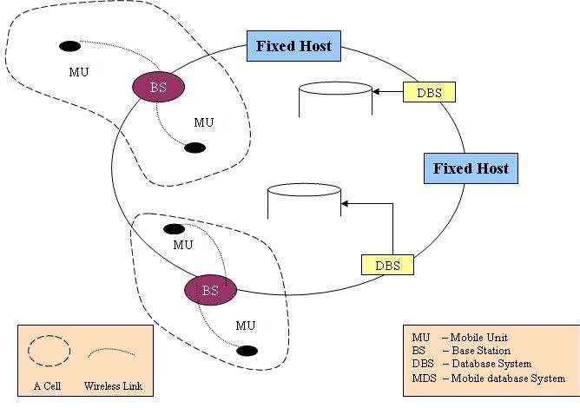
When a mobile unit leaves a cell serviced by a particular base station, that station transparently transfers the responsibility for the mobile unit's transaction and data support to whichever base station covers the mobile unit's new location

Slide 112
APPLICATIONS OF MOBILE DATABASES
BUSINESS
information on customers, competitors, and market trends – anytime, anywhere….
Salespersons can update sales & customer data on the move.
PUBLIC SECTOR
US Army uses mobile database technology to get current inventory and readiness info that can save them logistical costs.
9/3/2012
‹#›

Slide 113
HEALTH SECTOR
Used by Physicians to store and retrieve information while making their rounds.
Used by doctors & Para medics to retrieve vital patient history & treatment info while attending to patients in battle fields & remote accident locations..
9/3/2012
‹#›

Slide 114
Limitations :
It has Limited wireless bandwidth.
In the mobile database, Wireless communication speed.
It required Unlimited battery power to access.
It is Less secured.

Slide 115
Summary
1 Database Security and Authorization
2 Discretionary Access Control
3 Mandatory Access Control and Role-Based Access Control for Multilevel Security
4 Statistical Database Security
5 Flow Control
6 Encryption and Public Key Infrastructures

Slide 116
Discretionary Access Control (DAC)
For each subject access right to the objects are defined
(subject, object, +/- access mode)
(Black, Employee-relation, read)
User based
Grant and Revoke
Problems:
- Propagation of access rights
- Revocation of propagated access rights

Slide 117




DAC by Grant and Revoke
GRANT SELECT ON Employee
TO Black
WITH GRANT OPTION
GRANT SELECT ON Employee
TO Red
Black
Red
?
Brown revokes grant
given to Black
?
Brown does not want
Red to access the
Employee relation
Brown (owner)
GRANT UPDATE(Salary) ON Employee TO White
White

Slide 118
Implementation
File 1 File 2
Joe:Read Joe:Read
Joe:Write Sam:Read
Joe:Own Sam:Write
Sam:Own
Access Control List (column)
(ACL)
Capability List (row)
Joe: File 1/Read, File 1/Write, File 1/Own, File 2/Read
Sam: File 2/Read, File 2/Write, File 2/Own
Subject Access Object
Joe Read File 1
Joe Write File 1
Joe Own File 1
Joe Read File 2
Sam Read File 2
Sam Write File 2
Sam Own File 2
Access Control Triples

Slide 119
Access Control Mechanisms
Security through Views
Stored Procedures
Grant and Revoke
Query modification

Slide 120
Security Through Views
Assign rights to access predefined views
CREATE VIEW Outstanding-Student
AS SELECT NAME, COURSE, GRADE
FROM Student
WHERE GRADE > B
Problem:
Difficult to maintain updates.

Slide 121
Stored Procedures
Assign rights to execute compiled programs
GRANT RUN ON <program> TO <user>
Problem:
Programs may access resources for which the user who runs the program does not have permission.

Slide 122
Grant and Revoke
GRANT <privilege> ON <relation>
To <user>
[WITH GRANT OPTION]
------------------------------------------------------------------------------------------------------------------------------------
GRANT SELECT * ON Student TO Matthews
GRANT SELECT *, UPDATE(GRADE) ON Student TO FARKAS
GRANT SELECT(NAME) ON Student TO Brown
GRANT command applies to base relations as well as views

Slide 123
Grant and Revoke
REVOKE <privileges> [ON <relation>]
FROM <user>
-------------------------------------------------------------------------------------------------------------------------
REVOKE SELECT* ON Student FROM Blue
REVOKE UPDATE ON Student FROM Black
REVOKE SELECT(NAME) ON Student FROM Brown

Slide 124
Non-cascading Revoke
B
E
A
D
C
F
A revokes D’s privileges
E
B
A
C
F

Slide 125
Cascading Revoke
B
E
A
D
C
F
A revokes D’s privileges
B
A
C

Slide 126
Positive and Negative Authorization
-
B
E
+
+
A
D
-
Problem:
Contradictory authorizations
GRANT <privilege> ON X TO <user>
DENY <privilege> ON X TO <user>
C

Slide 127
Negative Authorization
-
B
E
+
-
+
A
D
+
-
C
F
What should happen with the privilege given by D
To F?

Slide 128
Query Modification
GRANT SELECT(NAME) ON Student TO Blue WHERE COURSE=“CSCE 590”
Blue’s query:
SELECT *
FROM Student
Modified query:
SELECT NAME
FROM Student
WHERE COURSE=“CSCE 590”

Slide 129
DAC Overview
Advantages:
Intuitive
Easy to implement
Disadvantages:
Inherent vulnerability (look TH example)
Maintenance of ACL or Capability lists
Maintenance of Grant/Revoke
Limited power of negative authorization

Slide 130
Mandatory Access Control (MAC)
Security label
- Top-Secret, Secret, Public
Objects: security classification
- File 1 is Secret, File 2 is Public
Subjects: security clearances
- Brown is cleared to Secret, Black is cleared to Public
Dominance (≥)
- Top-Secret ≥ Secret ≥ Public

Slide 131
MAC
Access rights: defined by comparing the security classification of the requested objects with the security clearance of the subject
If access control rules are satisfied, access is permitted
Otherwise access is rejected
Granularity of access rights!

Slide 132
MAC – Bell-LaPadula (BLP) Model
Single security property: a subject S is allowed a read access to an object O only if label(S) dominates label(O)
Star-property: a subject S is allowed a write access to an object O only if label(O) dominates label(S)
No direct flow of information from
high security objects to low security objects!

